Slide 1
RECURRENT NEURAL NETWORKS:
Jaya Sil
Bengal Engineering and Science University, Shibpur
Howrah-711103
Notes:
<number>

Slide 2
Recurrent
The network we have encountered so far are known as feedforward networks since they have no loops in them.
In such networks, the relationship between the input and the output can be expressed as a static function.
But loops are more common in the brain.
Hopfield network is a simple neural network model that has feedback connections and present a model of human memory, known as an associative memory

Slide 3
SELF ORGANIZED LEARNING
Motivated by neurobiological consideration and implemented with a set of rules of local behaviour.
Local means adjustment of synaptic weights of each neuron in the network confined to the immediate local neighborhood of the neuron.
Modification of the synaptic weights of the neuron based on presynaptic and postsynaptic signals available at the local level.
The neurobiologically motivated rules of self-organization mechanism is the very essence of Hebbian learning.

Slide 4
HEBBIAN NETWORK (1949)
When an axon of cell or neuron A excites a cell or neuron B, neuron B fires, and if this situation occurs repeatedly or persistently, then some growth process or metabolic changes take place in one or both the cells or neurons such that A’s efficiency to fire neuron B is increased.
x_{j}
y_{i}
A
B
Hebbian Hypothesis: The synaptic strength of brain changes proportionately to the correlation between the firing of the pre and postsynaptic neurons.

Slide 5
RECURRENT NEURAL NETWORKS
In RNN self-loops and backward connections between nodes are allowed.
RNNs with symmetric weight connections always converge to a stable state.
Single layer RNN and multilayer RNN.
Discrete Hopfield network is single layer RNN.
A single layer discrete Hopfield network is generalized to a continuous model.

Slide 6
HOPFIELD NETWORK
A Hopfield network is a single layer recurrent ANN popularized by John Hopfield in 1982.
It consists of a single layer which contains one or more fully connected recurrent neurons.
A Hopfield Network is a model of associative memory and functioning based on Hebbian learning.
It provides a formal model which can be analysed for determining the storage capacity of the network.
Two basic models of associative memories: Discrete and Continuous Hopfield
Hopfield networks classify binary pattern vectors.
Notes:
<number>

Slide 7
ASSOCIATIVE MEMORY NETWORK
Associative memory stores a set of patterns as memories do.
It can recall a key pattern thorough association of stored patterns.
Content addressable memory (CAM) in contrast to that of traditional address-addressable memories.
Associative memory: Auto-associative and Hetero-associative.
Notes:
<number>

Slide 8
ASSOCIATIVE MEMORY
Autoassociative memory: x^{i} = y^{i} where x^{i} ∈ ℜ^{n} and y^{i} ∈ ℜ^{m}
The network implements a mapping φ of ℜ^{n} to ℜ^{n} such that φ(x^{i}) = x^{i}
If some arbitrary pattern x is closer to x^{i} than to any other pattern x^{j} then φ(x) = x^{i} where i ≠ j
In the heteroassociative memory, the network implements a mapping φ of ℜ^{n} to ℜ^{m} such that φ(x^{i}) = x^{i}
If some arbitrary pattern x is closer to x^{i} than to any other pattern x^{j} then φ(x) = y^{i} where i ≠ j
Closer means with respect to some distance measure for binary pattern Hamming distance is used

Slide 9
Networks are single layered in which the weights are determined in a manner so that the network stores a set of pattern associations.
Each of this association is input-output vector pair.
Output vectors is same as input vectors, called Autoassociative, if different then the network is called Heteroassociative.
The Architecture of the network is either feed forward or Recurrent Neural Network.
Hebbian Learning rule is used to finding the weights

Slide 10
WEIGHT COMPUTATION
Input ⇒ S = [s₁, . . . . , s_{i}, . . . . , s_{n}]^{T}
Output ⇒ P = [p₁, . . . . , p_{i}, . . . . , p_{m}]^{T;}
A set of associations, s(k) : p(k), k = 1 to K (no. of patterns)
s₁p₁ …. s₁p_{j} …..s₁p_{m}
SP = S^{T}P = W = . . .
s_{i}p₁ …. s_{i}p_{j} ….. s_{i}p_{m}
. . .
s_{n}p₁ …. s_{n}p_{j} ….. s_{n}p_{m}
Weight matrix is called cross correlation matrix
K
w_{ij} = Σ_{k=1} s_{i}^{T}(k). p_{j} (k);
the weight matrix is obtained using Hebbian rule.
Notes:
<number>

Slide 11
x_{n}
x₂
No self feedback, w_{ii}=0 and weights are symmetric, w_{ij} = w_{ji}
Each node has an external input and threshold θ_{j}, j = 1…n
x₁
w_{n1}
w₂₁
-1
θ₁
y_{n}
y₂
y₁
Every pair of units i and j in a Hopfield network have a connection described by the weight w_{i j}.
Notes:
<number>

Slide 12
How to "train" a Hopfield network
The input and output patterns are discrete vector, which can be either binary (0,1) or bipolar (+1, -1) in nature.
Calculate the values of the weights without any training.
Store the set of binary patterns V^{s}, s = 1, ..., n.
W_{ij} = ∑^{n}_{s=1} (2V^{s}_{i} - 1)(2V^{s}_{j} - 1) for i ≠ j
For Bipolar input pattern W_{ij} = ∑^{n}_{s=1} (V^{s}_{i})(V^{s}_{j}) for i ≠ j

Slide 13
The constraint that weights be symmetric guarantees that the energy function decreases monotonically.
Each neuron receives a weighted sum of the inputs from other neurons:
n
y_{i}= ∑ x_{j} w_{ij} ; If y_{i} is positive the state of the neuron
j=1 will be 1, otherwise 0:
j≠i
n
Update rule: y_{i}^{(k+1)} = sgn ( ∑ w_{ij} y_{j}^{(k)} + x_{i} - θ_{i} ); i = 1…n
j=1
j≠i
The connection weight w_{ij} > 0 implies:
that y_{j} = 1 the contribution of j in the weighted sum is positive.
Thus, y_{i} is pulled by j towards its value 1 and vice versa.
Notes:
<number>

Slide 14
BIDIRECTIONAL ASSOCIATIVE MEMORY
BAM performs forward and backward associative searches
BAM is a recurrent Heteroassociative pattern matching network that encodes binary or bipolar patterns using Hebbian learning rule.
X layer w Y layer
Two types of BAM: discrete and continuous.
w^{T}
Notes:
<number>

Slide 15
BAM
The activation function is nonzero threshold, i.e. step function.
A continuous BAM transforms the input smoothly and continuously in the range 0-1.
For continuous BAM activation function is binary or bipolar sigmoidal function.
f(net) = 1/ 1+e^{-net}
f(net) = 1- e^{-net}/ 1+e^{-net}

Slide 16
Updating Rule
Thus, the values of neurons i and j will converge if the weight between them is positive. Similarly, they will diverge if the weight is negative.
Asynchronous: Only one unit is updated at a time. This unit can be picked at random, or a pre-defined order can be imposed from the very beginning.
Synchronous: All units are updated at the same time. This requires a central clock to the system in order to maintain synchronization.

Slide 17
Consider a two node discrete Hopfield network with w₁₂ = w₂₁ = -1, w₁₁ = w₂₂ = 0 , x₁ = x₂ = 0 and θ₁ = θ₂ = 0 and the initial output vector y⁽⁰⁾ = [-1 -1]^{T}
According to the asynchronous update rule, only one node is considered at a time.
Assume that the first node is chosen for update.
So y₁⁽¹⁾ = sgn (w₁₂ y₂⁽⁰⁾) = sgn [ (-1) (-1)] = 1 and y⁽¹⁾ = [1 -1]^{T}
y₂⁽²⁾ = sgn (w₂₁ y₁⁽¹⁾) = sgn [ (-1) (1)] = - 1 and y⁽¹⁾ = [1 -1]^{T}
No further output state changes will occur and that the state
[1 -1]^{T} is an equilibrium state of the network.

Slide 18
Asynchronous Update
Using different initial outputs, we can obtain the state transition diagram, in which the vectors [1 -1]^{T} and [-1 -1]^{T} are the two equilibria of the system.
[1 -1]^{T}
[1 1]^{T}
[-1 -1]^{T}
[-1 1]^{T}

Slide 19
Synchronous Update
For the same initial output vector [-1 -1]^{T}
we have y(¹⁾ = [ 1 1]^{T} and y(²⁾ = [ -1 -1]^{T}
Same as initial output vector y⁽⁰⁾
The synchronous produces a cycle of two states rather than a single equilibrium state.
Synchronous update may cause the networks to converge either to fixed points or limit cycles.

Slide 20
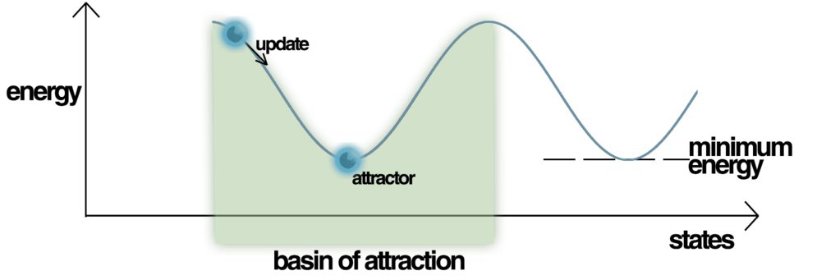
Energy
The network is characterized by an energy function to evaluate the stability property of a discrete Hopfield network.
Energy Landscape of a Hopfield Network, highlighting the current state of the network (up the hill), an attractor state to which it will eventually converge, i.e. a minimum energy level and a basin of attraction shaded in green.
Hopfield nets have a scalar value associated with each state of the network referred to as the "energy", E, of the network.

Slide 21
STABILITY PROPERTY
Energy function: n n n n
E = -½ ∑ ∑ w_{ij} y_{i} y_{j} - ∑ x_{i} y_{i} + ∑ θ_{i} y_{i}
i=1 j=1 i=1 i=1
j≠i
In stable network the energy function decreases during change of state of any node.
Assume that node i changes state from y_{i}^{(k)} to y_{i}^{(k+1)}.
So its output changes from +1 to –1 or vice versa.
Notes:
<number>

Slide 22
Change in energy:
n
ΔE = E(y_{i}^{(k+1)}) - E (y_{i}^{(k)} ) = - ( ∑ w_{ij} y_{j}^{(k)} + x_{i} - θ_{i} ) (y_{i}^{(k+1)}- y_{i}^{(k)})
j=1, j≠i
ΔE = - (net_{i}) Δy_{i} where Δy_{i} = y_{i}^{(k+1)} - y_{i}^{(k)}; y_{j}^{(k+1)} = y_{j}^{(k)}; w_{ij} = w_{ji} and w_{ii}=0
Case I: If y_{i}^{(k)} has changed from -1 to +1; i.e. (Δy_{i} = +2), then net_{i} must be positive and ΔE will be negative.
Case II: If y_{i}^{(k)} has changed from +1 to -1; i.e. (Δy_{i} = -2), then net_{i} must have been negative and ΔE will be again negative.
Case III: If y_{i}^{(k)} has not changed (Δy_{i} = 0), so ΔE = 0. Thus ΔE ≤ 0 always.

Slide 23
Lyapunov Function
The energy function has to reach its local minimum.
Starting at any initial state, a Hopfield network always converges to a stable state after a finite number of node updating steps.
Lyapunov Stability theorem is used to prove the stability of a dynamic system defined with differential equations.
Notes:
<number>

Slide 24
Boltzmann Machine
A Boltzmann Machine is a network of binary units, like a Hopfield net.
Energy function is exactly the same as discrete Hopfield net.
In updating units, we use the same rule of summing up all weighted inputs and estimating unit’s output by the sum.
We use different activation function instead of Hopfield’s binary threshold one.
Boltzmann Machine is not a memory network.

Slide 25
Boltzmann Machine
Boltzmann Machines consist of stochastic neurons, which have one of the two possible states, either 1 or 0.
If we apply simulated annealing on discrete Hopfield network, then it would become Boltzmann Machine.
Boltzmann machine is a single layer fully connected recurrent network.
The ability to escape from local minima by changing the weight between the two units it connects and achieve global minimum - Ackley, Hinton 1985

Slide 26
Simulated Annealing
Simulated Annealing process causes the global energy function of the metal to reach an absolute minimum value eventually.
If the temperature is dropped too quickly, the energy of the metallic lattice will be much higher than the minimum value.
Cooling procedure in the simulated annealing process is such that the system has a higher probability of achieving an increasing energy-state change in the early phase of convergence.
The system becomes stable and always changes its state in the direction of decreasing energy i.e. gradient descent method.

Slide 27
State Change Probability
A system changes its state from the original state s^{old} to a new state s^{new} with a probability p.
p = [1+exp(- ΔE / T)]⁻¹ where ΔE = E ^{old} – E ^{new} and T is a nonnegative parameter i.e. temperature of a physical system.
p
T= ∞
0.5
T= 1 T=0
Probability with ΔE > 0 is always higher than the probability with ΔE < 0 for any temperature.
Since system energy always decreases.
-6
0
ΔE
6

Slide 28
Stochastic Update Rule
y_{i}^{new} = 1 if z ≤ p_{i} = [1+exp(- ΔE_{i} / T)]⁻¹
= y_{i}^{old} otherwise,
y_{i} is 1 or 0 for i = 1,2,…n and z is a random number between 0 and 1.
n
ΔE_{i} is defined by ΔE_{i} = E_{yi =0} - E_{yi =1} = ∑ w_{ij} y_{j} = net_{i}
_{j=1}
The update rule is performed asynchronously and randomly.
Temperature T is lowered either when the energy has dropped quite a bit or when a sufficiently large number of updates has occurred.

Slide 29
Boltzmann machine may or may not converge to a final stable state unlike Hopfield network.
Usually, the state achieves at termination is very close to the global minimum of the energy function E.
The update rule ensures that in thermal equilibrium the relative probability of two global states is determined by energy difference and follow Boltzmann distribution.
p_{α} / p_{β} = e ^{-(Eα - Eβ ) / T} and p_{α} = C e ^{–Eα / T}
Where p_{α} is the probability of being in the α-th global state, E_{α} is the energy of that state. C is a constant: C = (∑ _{α} e ^{–Eα / T} )⁻¹ from the fact that ∑_{α} p_{α} = 1

Slide 30
Boltzmann Machine
Boltzmann machine is useful to solve certain types of optimization problems.
Proper weights are required to solve optimization problems.

Slide 31
Memory unit
Boltzmann machine is also used as an associative memory where some nodes to be hidden nodes.
Part of the nodes are treated as visible nods and rest as hidden nodes.
The visible nodes are further divided as input and output nodes, called heteroassociative memory.
The hidden nodes have no connection with the outside world.

Slide 32
Learning of Boltzmann Machine
Adjust weight w_{ij} to give the states of the visible nodes a particular desired probability distribution.
This step is for storing the patterns in the memory.
Learning is accomplished using simulated annealing process.
Let q(y) be a probability distribution over y presented to the machine.
Adjust weight so that p(y) becomes close to q(y)

Slide 33
Learning Rule
Δw_{ij} = Δw_{ji} = η(q_{ij} –p_{ij}); η is a small constant
q_{ij} = E_{q} [y_{i} y_{j}] = ∑_{y} q(y) y_{i} y_{j} and p_{ij} = E_{p} [y_{i} y_{j}] = ∑_{y} p(y) y_{i} y_{j}
E_{q} and E_{p} denote expectation operation w.r.t. the probability distributions q(y) and p(y).
q_{ij} is the relative frequency at which both y_{i} and y_{j} are jointly excited under the probability distribution q(y), called q phase.
p_{ij} is the relative frequency at which both y_{i} and y_{j} are jointly excited under the probability distribution p(y), called p phase.

Slide 34
Learning Rule
The learning is realized by Hebbian synaptic modification method in two phases.
First phase: Input learning phase, weight w_{ij} is increased by a small amount whenever both y_{i} and y_{j} are excited by an input y; hence on average the increment of w_{ij} is proportional to q_{ij}.
Second phase: Unlearning phase w_{ij} is decreased by the same small amount when ever both y_{i} and y_{j} are excited by a free state transition; decrement of w_{ij} proportional to p_{ij} on an average.

Slide 35
Continuous Hopfield Networks
A discrete Hopfield network is generalized to a continuous model in which time is a continuous variable and the nodes have a continuous graded output.
The energy of the continuous Hopfield network decreases continuously with time.
Continuous Hopfield network is analogous to an electronic circuit.
The model of a continuous Hopfield network is realized using electronic components - nonlinear amplifiers and resistors .

Slide 36
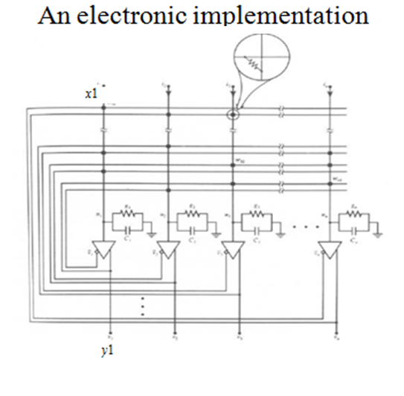
w_{1n}
u_{i}
The circuit consists of n amplifiers (nodes).
Mapping input voltage u_{i} into an output voltage y_{i} through the activation function a(u_{i} ).

Slide 37
Electronic Circuit
a(λu_{i} ) = (1 + e^{-λu}_{i} )⁻¹ λ is called the gain parameter.
When λ → ∞, a continuous model becomes a discrete one.
Each amplifier has an input conductance g_{i} and an output capacitance c_{i} and have an external input signal x_{i}.
Conductance w_{ij} connects the output of the j-th node to the input of the i-th node.
Inverted node outputs y_{i} are used to simulate inhibitory signals as real resister values are positive.

Slide 38
Electronic Circuit
If the output of a particular node excites some other node, then the connection is made with the signal from the noninverted output.
If the connection is inhibitory then it is made from the inverted output.
Symmetric weight requirements is imposed.

Slide 39
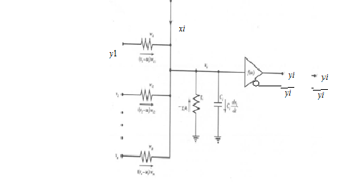
Evolving Rule of each node
(y₁-u_{i})w_{i1}
Kirchhoff current law- total current entering a junction is equal to that leaving the same junction.

Slide 40
Energy Function
Each node is given an initial value u_{i}(0) then the value u_{i}(t) and amplifier output y_{i}(t) = a(u_{i}(t)) at time t is solved taking differentiation.
For evaluating stability property define a continuous energy function such that evolution of the system is in the direction of negative gradient of the energy function.
Finally converges to one of the stable minima in the state space.

Slide 41
UNSUPERVISED LEARNING
In unsupervised learning only input data (X) is given and no corresponding output variables.
The goal for unsupervised learning is to model the underlying structure or distribution in the data in order to learn more about the data.
If an input space is to be processed by a neural network, the first issue of importance is the structure of this space.
A neural network with real inputs computes a function f defined from an input space A to an output space B.
Notes:
<number>

Slide 42
UNSUPERVISED LEARNING
During training of the ANN, the input vectors of similar type are combined to form the clusters.
When a new input pattern is applied, then the ANN gives an output response indicating the class to which the new input pattern belongs.
No feedback from the environment as to what should be the desired output and whether it is correct or incorrect.
The network itself must discover the input patterns and relationship.

Slide 43
UNSUPERVISED LEARNING
Relationships of interest that may exist in the input data:- similarity and correlation.
Translate the discovered relationship into outputs.
Unsupervised learning problems are grouped into clustering (discover inherent similarity or dissimilarity in the data) and association problems (discover rules describing association of data).
Examples: k-means for clustering and Apriori algorithm.
The networks are called self-organizing networks.

Slide 44
Topographic Maps
Neurobiological studies indicate that different sensory inputs (motor, visual, auditory, etc.) are mapped and processed in different regions of cerebral cortex of our brain.
The visual cortex is a well-studied region in the posterior part of the human brain.
At each stage of representation, or processing, each piece of incoming information is kept in its proper context/neighbour.
The visual information is mapped as one or two dimensional projection on the cortex.

Slide 45
KOHONEN’s NETWORK
Neurons work together to decode and process visual impressions.
Neurons dealing with closely related pieces of information are kept close together so that they can interact via short synaptic connections.
Goal is to building artificial topographic maps that learn through self-organization in a neurobiologically inspired manner.
Kohonen’s model has a biological and mathematical background, called self-organizing networks.

Slide 46
WINNER-TAKES-ALL NETWORKS
Networks are based on the competitive learning rule.
The output nodes try to compete with each other to
represent the input pattern.
During training, the output unit with highest activation to a given input pattern, will be declared the winner.
Notes:
<number>

Slide 47
KOHONEN’s NETWORK
y₁ [w₁₁, w₂₁, w₃₂]
x₁
y_{i}
x₂
y_{n}
x_{m}
W
The objective of a Kohonen’s network is to transform input vectors (patterns) of arbitrary dimension N onto a discrete map, and perform this transformation adaptively in a topologically ordered fashion.
The neurons of the input layer transfer signal to the neurons of the output layer.
The output layer neurons compete with each other, having eventually one of the units (say i) as the winner.
Notes:
<number>

Slide 48
2-D Mapping

Slide 49
Theme is learn if win-
Competitive learning distributes the weight vectors to approximate the unknown probability density function of the random input vectors.
A competitive learning network performs clustering or similarity searching on the input patterns.
Algorithm uses distance measure between the input vector and weight vector and smallest distance is chosen as the winner.
Dot product between input and weight vector and largest is chosen as the winner.
Only the winning neuron is updated and the rest of the neurons are left unchanged.

Slide 50
WINNER-TAKE-ALL
The weights connected with the winner neuron are updated:
w_{kj}(t+1) = w_{kj}(t) - α(x_{j}-w_{kj}(t));
w_{kj}(t+1) = w_{kj}(t) if neuron k losses
α suitable learning constant.
The learning process stops when two consecutive weight changes are small enough.

Slide 51
SELF-ORGANIZING FEATURE MAP
Self organizing feature map follows winner takes all principle following spatial organization in the distribution of neurons.
Lattice of output neurons where neurons in the lattice space are arranged in 1D, 2D or even higher dimensions.
Feature mapping network converts patterns of arbitrary dimensionality into the responses of one or two dimensional arrays of neurons.
Map pattern space to feature space by reducing dimensionality.
The network obtains a topology preserving map by preserving neighbourhood relations of the input neuron.

Slide 52
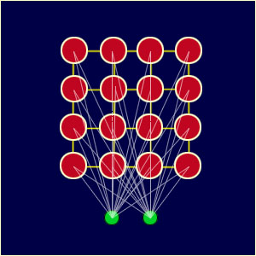
Consider the geometrical arrangements of output nodes.
Each node in a given layer has been identically connected with all of the nodes in the upper and/or lower layer.
Nodes that are "close" together are going to interact differently than nodes that are "far" apart.
More closely connected, more influence on other.
Each node has a specific topological position (an x, y coordinate in the lattice) and contains a vector of weights of the same dimension as the input vectors.

Slide 53
Weights connected between input and output node where the output node is represented by the weight, different operation than supervised.
The node weights match the input vector, that area of the lattice is selectively optimized to more closely resemble the data for the class the input vector is a member of.
From an initial distribution of random weights, and over many iterations, the SOM eventually settles into a map of stable zones.
Each zone is effectively a feature classifier, so think of the graphical output as a type of feature map of the input space.

Slide 54
A SOM does not need a target output to be specified
The node weights match the input vector, that area of the lattice is selectively optimized to more closely resemble the data for the class the input vector is a member of.
From an initial distribution of random weights, and over many iterations, the SOM eventually settles into a map of stable zones.
Each zone is effectively a feature classifier, so you can think of the graphical output as a type of feature map of the input space.

Slide 55
SOMs
Winner neuron goes close to the input and hence the other neuron as they are closely connected (neighbor).
Weights of all the neighbouring nodes are updated.
Close to the winner node updation is more and distant are less.
Neighbor is selected based on a topology.
Close nodes are dragged by the BMU depending on the distance.
After one epoch radius changes and process continues for different epochs.

Slide 56
TRAINING
1. Each node's weights are initialized.
2. A vector is chosen at random from the set of training data and presented to the lattice.
3. Every node is examined to calculate which one's weights are most like the input vector.
4. The winning node is commonly known as the Best Matching Unit (BMU).

Slide 57
5. The radius of the neighbourhood of the BMU is calculated.
6. This is a value that starts large, typically set to the 'radius' of the lattice, but diminishes each time-step.
7. Nodes found within this radius are deemed to be inside the BMU's neighbourhood.
8. Each neighbouring node's (the nodes found in step 4) weights are adjusted to make them more like the input vector. The closer a node is to the BMU, the more its weights get altered.
9. Repeat step 2 for N iterations

Slide 58
TRAINING

Slide 61
ADAPTIVE PROCESS

Slide 62
PROBLEM SOLVING
Select a suitable NN model based on the nature of the problem.
Construct a NN according to the characteristics of the application domain.
Train the neural network with the learning procedure of the selected model.
Use the trained network for making inference or solving problems.

Slide 63
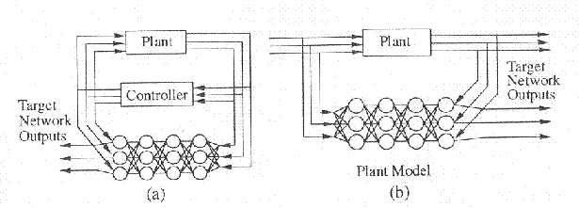
APPLICATIONS - Control Systems
Complex dynamical systems with uncertainty.
Systems identification and control.
Adaptively change the neural controller based on the critic signal.
Identify system failures and store Information for decision making.
Notes:
<number>

Slide 64
Example:
Two dimensional problem- Feature vector x=(x₁, x₂)
x₁: systolic blood pressure and x₂: white blood count
Two class problem- Class 1 : M1 and Class 2: Angina
Decision Surface: D(x) = w₁x₁ + w₂x₂
D(x) > 0; if x belongs class 1
D(x) < 0; if x belongs class 2.
Perceptron learning rule: w_{i}(t+1) = w_{i}(t) +η[d(t) - y(t)]x_{i}(t)
y(t) = 1; if D(x) > 0
y(t) = -1; if D(x) < 0
d(t)=1; if x belongs to class 1
d(t)=-1; if x belongs to class 2
Notes:
<number>

Slide 65
PATTERN CLASSIFICATION
Determine Parameters (Features) able to distinguish between different classes.
Feature extraction.
Feature extraction requires domain knowledge.
Decision Surface (separator) that divides the classes.
20
w
h
i
t
e
B
l
o
o
d
C
o
u
n
t
10
0
15
30
Systolic Blood Pressure /100
Notes:
<number>

Slide 66
BIOMEDICAL APPLICATIONS
Clustering for classification of cell types.
Clustering and Dimensionality Reduction.
Global classification of known Protein sequences.
Segmentation of Protein sequences
Notes:
<number>

Slide 67
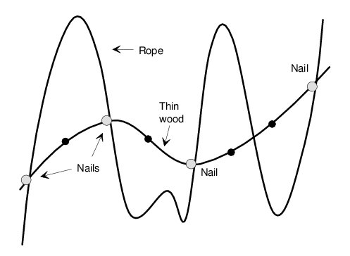
OVER-FITTING
Be sure that the number of trainable weights influencing any particular output is smaller than the number of training samples

Slide 68
THANK YOU

